Slide 1
PRESENTATION TITLE
.
1mg Homeopath medicine Data Analysis
.
Mirjam Nilsson​
Presented by:
Ruchi Pandey
Palak Agrawal
Keerthishankar
Teja Polipogu
Raghav

Slide 2
Project Aim :
We are undertaking this project to meet the increasing demand for reliable homeopathic medicines in the market.
Our goal is to provide high-quality and genuine products that are currently lacking or limited in availability.
We aim to support alternative healthcare options and cater to individuals seeking holistic remedies.

Slide 3
Objectives of this project
Scraped and Analyse data to identify the most effective and popular homeopathic medicines.
Choose the best products based on customer preferences.
Reduce costs and maximize profits.
Ensure customer satisfaction with a curated selection of quality offerings.
Gain a competitive advantage and achieve sustainable growth.

Slide 4
ABOUT 1mg
It is an online healthcare platform and a trusted name in the healthcare industry in India. They provide various services such as online medicine ordering, booking lab tests, consulting with doctors, and accessing reliable healthcare information.

Slide 5

Insights
.

Slide 6
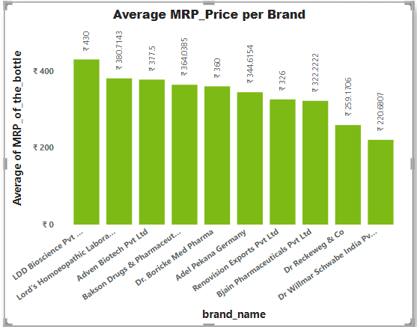

Slide 7
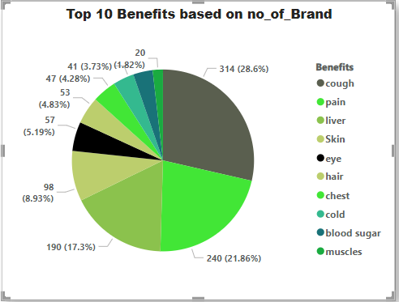
.
.
.
.

Slide 8
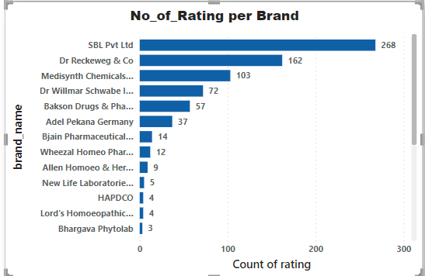
TIMELINE
SEP 20XX
NOV 20XX
JAN 20XX
MAR 20XX
MAY 20XX
Synergize scalable e-commerce
Disseminate standardized metrics
Coordinate e- business applications
Foster holistically superior methodologies
Deploy strategic networks with compelling e- business needs

Slide 9
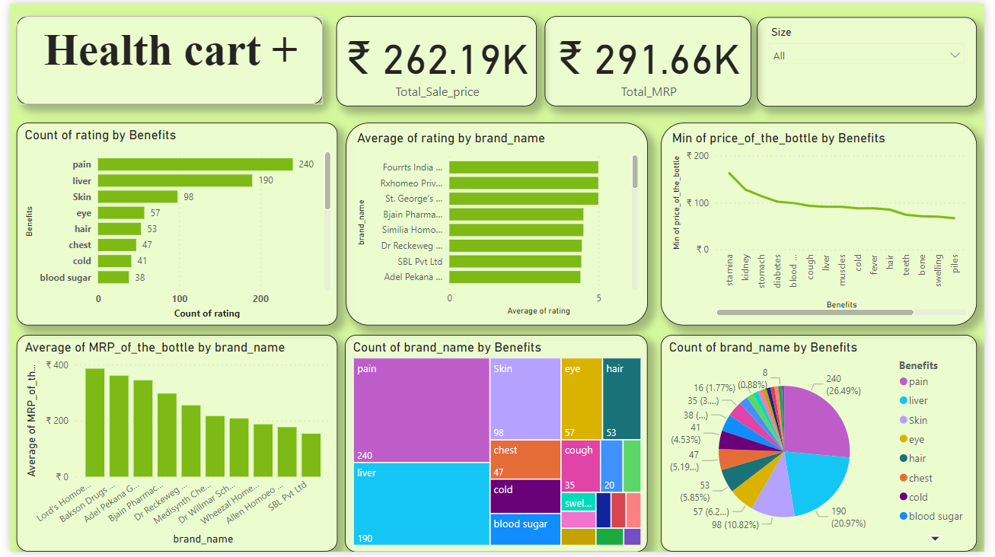
AREAS OF FOCUS
Dynamic Dashboard
B2B MARKET SCENARIOS
CLOUD-BASED OPPORTUNITIES
Develop winning strategies to keep ahead of the competition
Capitalize on low-hanging fruit to identify a ballpark value
Visualize customer directed convergence
Iterative approaches to corporate strategy
Establish a management framework from the inside

Slide 10
Future Scope
Promising future scope: The industry shows
potential for growth and development.
Market opportunities: Price variations across
benefit areas indicate untapped potential for expansion.
Expanding product offerings: Targeting underutilized sectors like joints, hair, blood, and respiratory issues can tap into new markets.
Advancements and acceptance: Research, technology, and holistic healthcare trends improve industry growth and consumer accessibility

Slide 11
Learnings :
Challenges :
Find some difficulty while scrapping 1mg Data , Due to dynamic Site
Complex HTML
Time Management
.
Web Scraping
Basic Understanding of HTML Script
New Python Library like BeautifulSoup
Effective Teamwork

Slide 12
THANK YOU
.

